Slide 1
Computer program for handicapped
Piotr Machura and Maciek Rekke

Slide 2
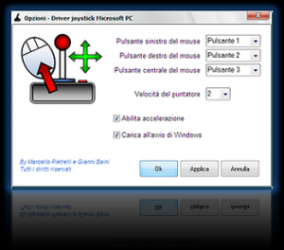
Joy to mouse
is designed for people, who have problem with hands (trembling, arthritis etc.)
let for replacment mouse gamepad or joystick
enable define display’s button to action (for example: click right button on mouse)

Slide 3
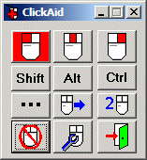
Click aid
helps people, who have problem with clicking
handicapped person moves cursor on special panel, where are avaible actions in graphic forms
similary application is Clikka mouse

Slide 4
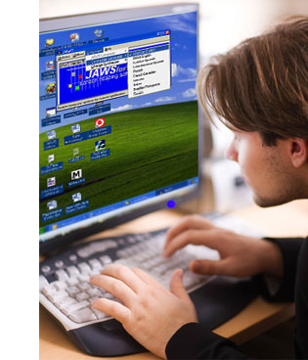
JAWS
is a computer screen reader program for Microsoft Windows that allows blind and visually impaired users to read the screen either with a text-to-speech output or by a Refreshable Braille display.
during installation we can choose our language from 24 avaible
disadvantage of this program is a price (Standard – 895$, Professional 1095$)

Slide 5
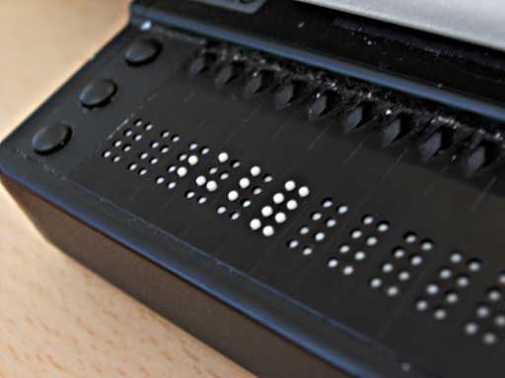
JAWS
How it works
Text-to-speech
Refreshable Braille display

Slide 6
Other screen readers
Spikit (Polish program)
Windows Eye
HAL
Supernova
Zoomtext Magreader
Magic Plus
Lunar Plus
Dual

Slide 7
Software’s developers:
Harpo
Impuls
Disabled online
MEDISON
Altix

Slide 8
B-link
What is it?

Slide 9
B-link
is a computer program for handicapped people, who can’t move their limbs and head.
enables to surf the Internet, uses screen’s keyboard, runs application and also turns off computer through blink eyelid
was made in 2009 by TP (Polish Telecommunication) group
Only at installation program and mounting camera the assistance of fully-phisically-abled person is needed

Slide 10
B-link
What is needed to use program?

Slide 11
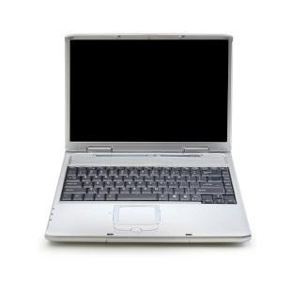
B-link
Web-camera
Computer with this specification:
processor Intel Core2Duo or faster
1 GB RAM
graphic card with min. 128 MB RAM
System Microsoft Windows XP with service pack 2, Vista or Windows 7
NET Framework 3.5

Slide 12
B-link
How it works?

Slide 13
B-link
camera detects face
blinks longer than ¼ sec is interpreted as action
on screen’s keyboard is moving action area, when we blink it stops and we choose by blinking action from this area

Slide 14
B-link
How much it costs?

Slide 15
B-link
b-link is completely free program
it is available on open source rules
you can download it from Orange and TP (Polish Telecomunication) sites

